Slide 1
Unit 8 The Media - Writing styles

Slide 2
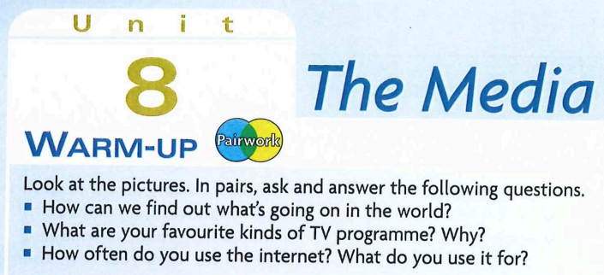

Slide 3
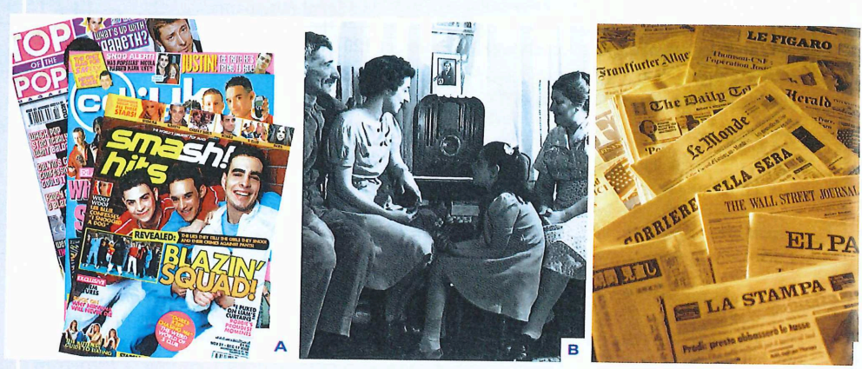

Slide 4
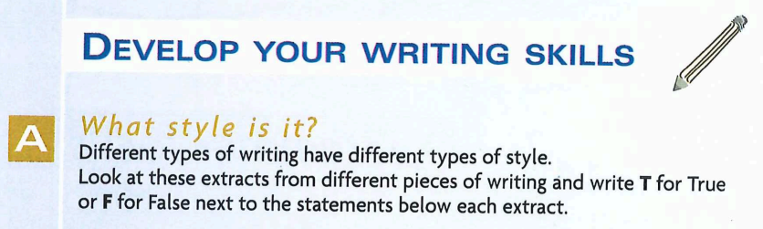

Slide 5
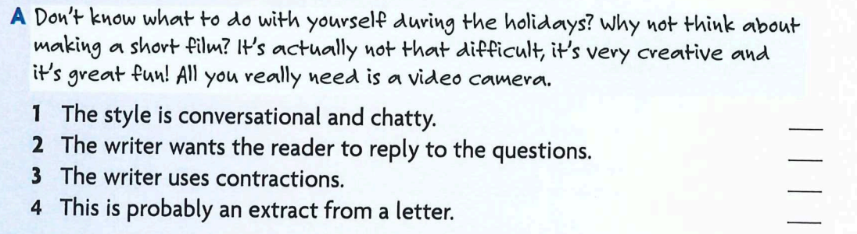
1
T
2
F
3
T
4
F

Slide 6
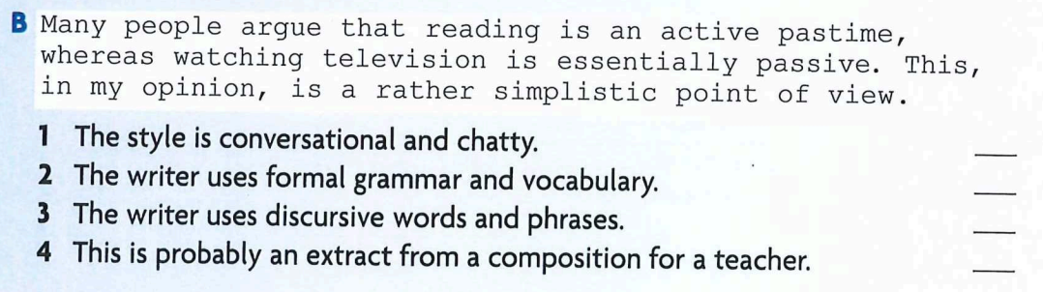
1
F
2
T
3
T
4
T

Slide 7
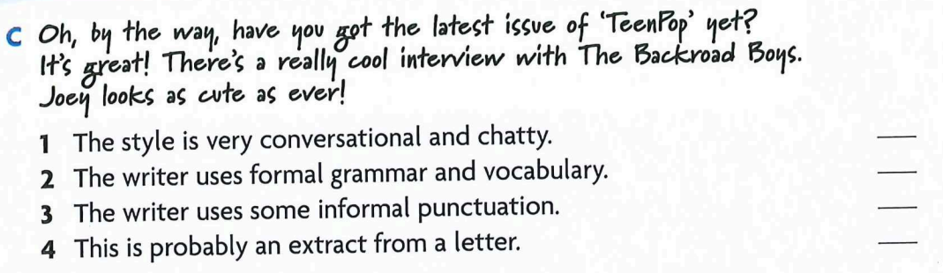
1
T
F
2
T
3
4
T

Slide 8
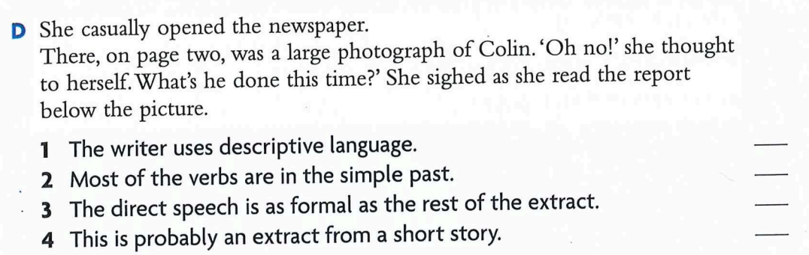
1
T
T
2
F
3
4
T

Slide 9
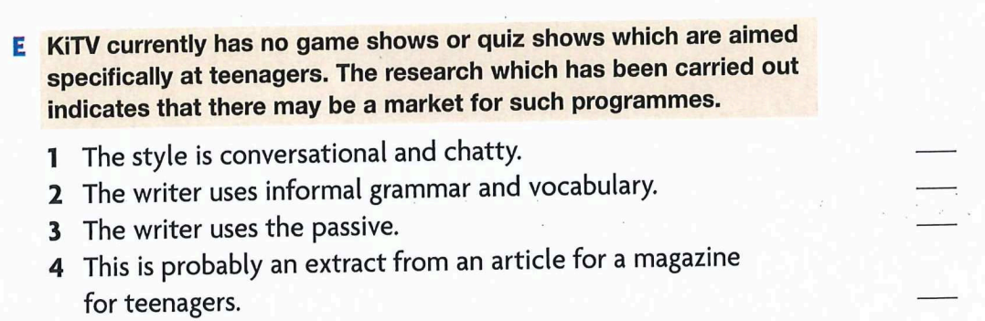
1
F
2
F
3
T
4
F

Slide 10
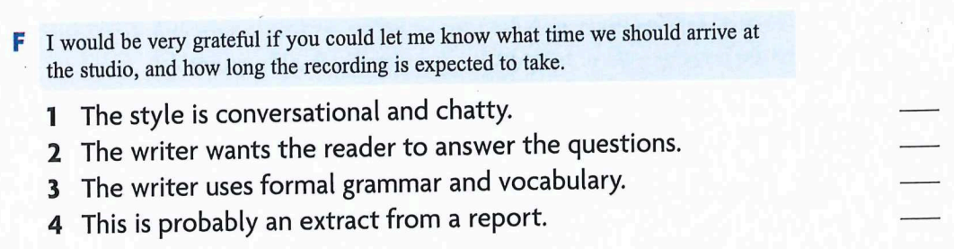
1
F
T
2
3
T
4
F
Notes:
）

Slide 11
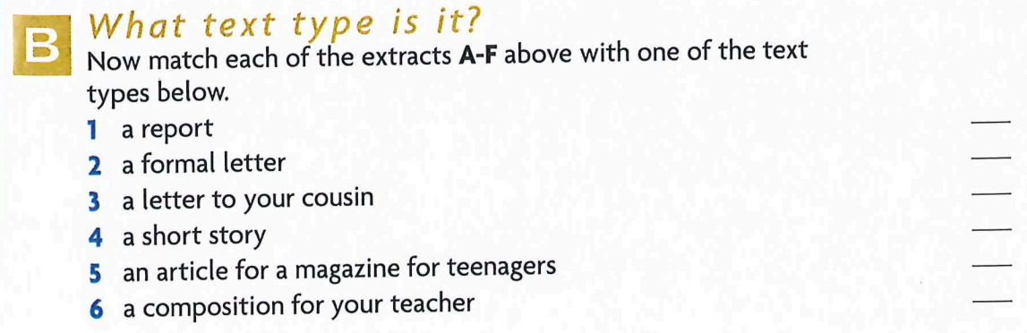

E
F
C
D
A
B

Slide 12
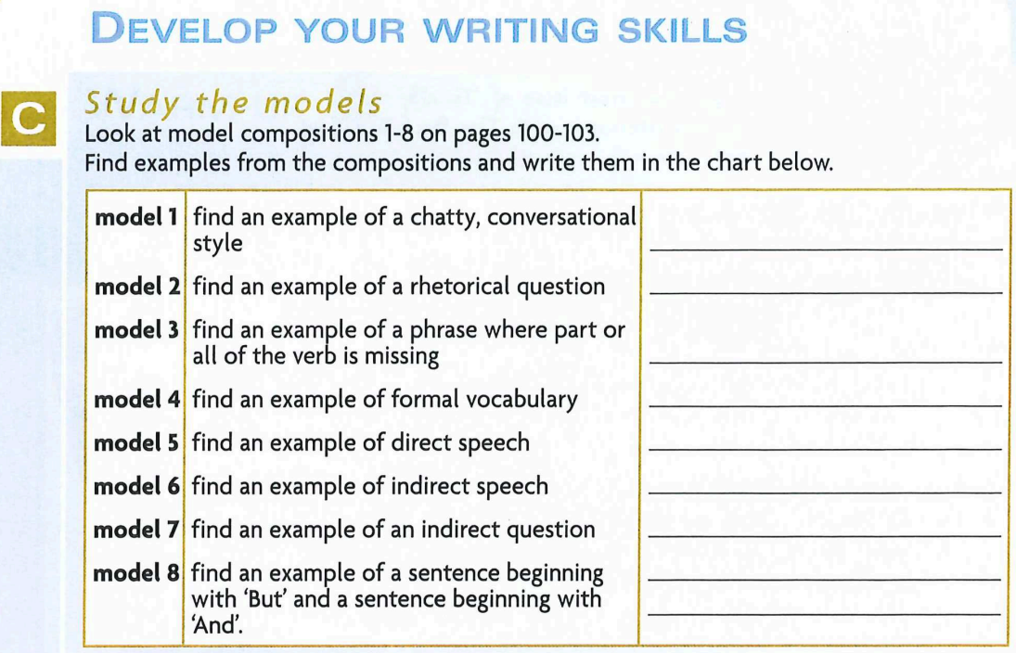

Slide 13
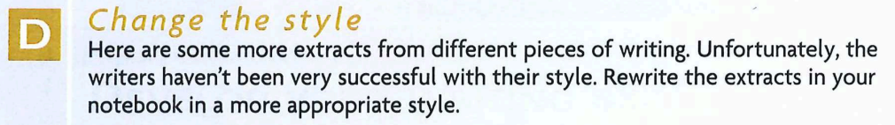

Slide 14
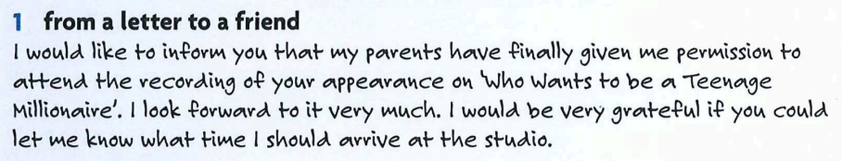

Slide 15
I just want to tell you that mum and dad have finally let me go to the recording of your appearance on ‘Who Wants to be a Teenage Millionaire’. I can’t wait to see it! What time should I be at the studio?

Slide 16
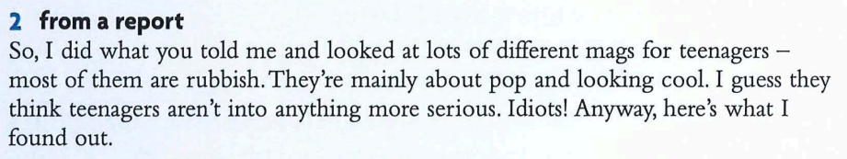

Slide 17
Several magazines aimed at teenagers were examined. Many of them were found to be of particularly poor quality. They are mainly about pop music and how to project a confident and stylish image. It would appear that they do not consider that teenagers are in the market for anything else. My findings are detailed below.

Slide 18
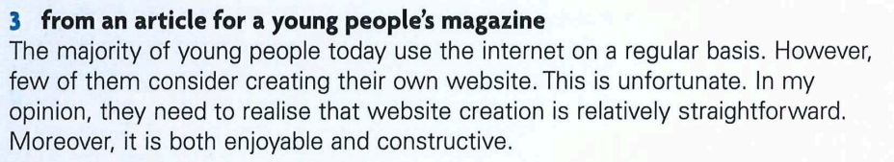

Slide 19
These days, everyone uses the internet all the time, but how many think about making their own website? Think it’s too hard? Actually, it’s dead easy and it’s really fun and cool!

Slide 20
Over‑formal expression (OP) Informal rewrite
"I would like to inform you my parents have finally given me permission to attend your performance…" "I just want to tell you that mum and dad have finally let me go…"
"your performance on 'Who wants to be a Teenage Millionaire'" "the recording of your appearance on 'Who Wants to be a Teenage Millionaire'"
"I look forward to it very much." "I can’t wait to see it!"
"I would be grateful if you could let me know what time I should arrive at the studio." "What time should I be at the studio?"

Slide 21
Match the over‑formal expressions in Column A with their informal equivalents in Column B.
Column A – Over‑formal expressions
A. I would like to inform you that my parents have finally given me permission…
B. …your performance on “Who Wants to be a Teenage Millionaire.”
C. I look forward to it very much.
D. I would be grateful if you could let me know what time I should arrive at the studio.
Column B – Informal expressions
1) I can’t wait to see it!
2) What time should I be at the studio?
3) I just want to tell you that mum and dad have finally let me go…
4) …the recording of your appearance on “Who Wants to be a Teenage Millionaire.”

Slide 22
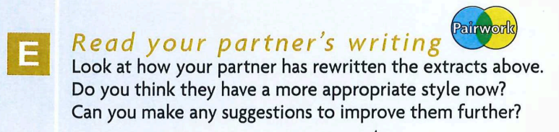

Slide 23
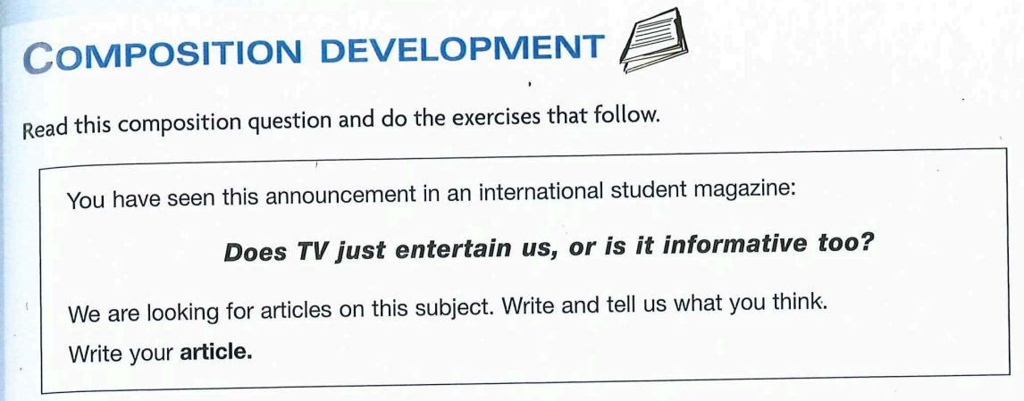

Slide 24
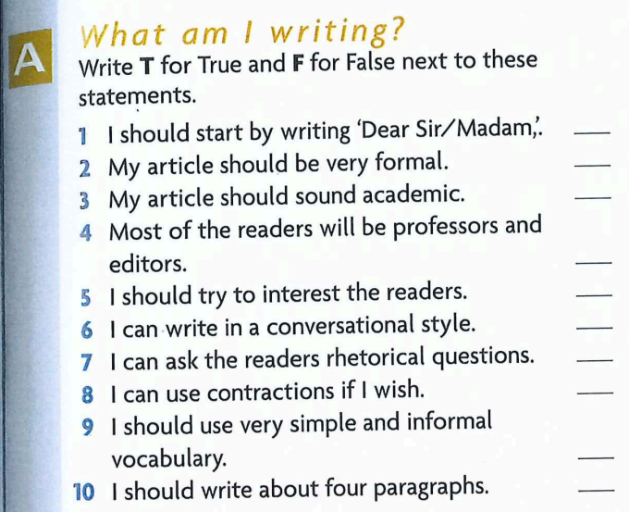
1
F
2
F
F
3
4
F
5
T
T
6
T
7
T
8
T
9
T
10

Slide 25
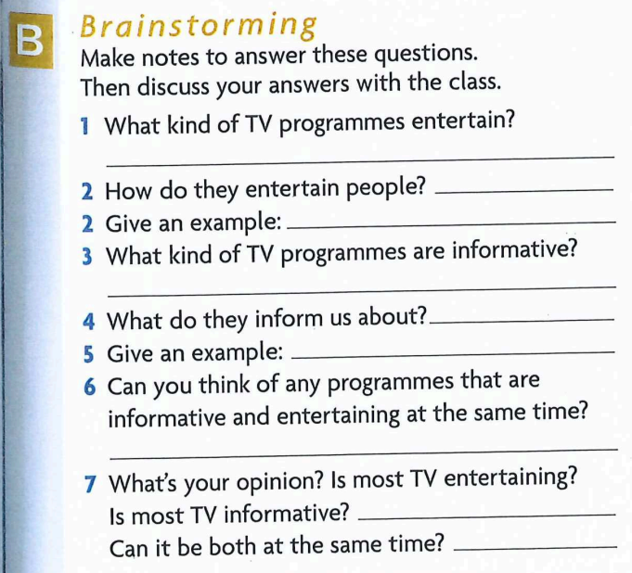

Slide 26
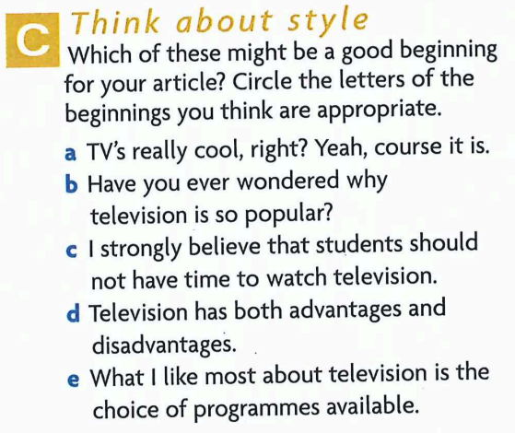

Slide 27
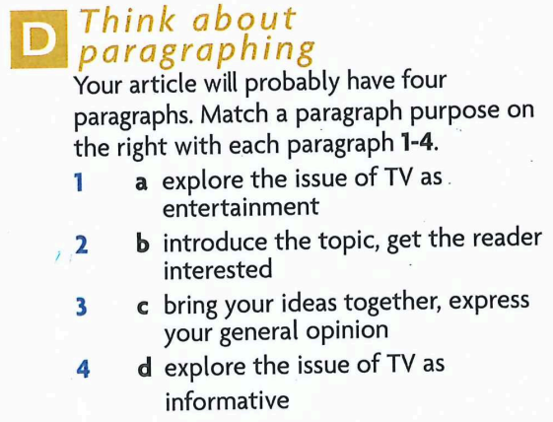
b
a
d
c

Slide 28
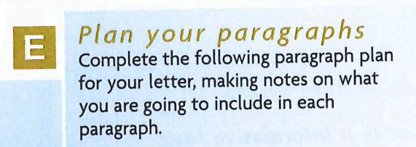

Slide 29
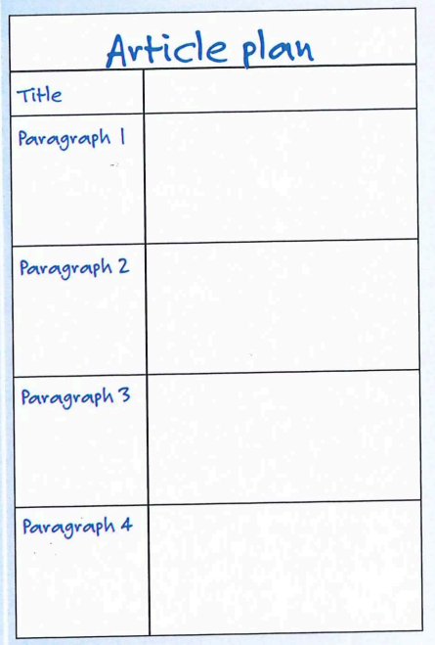

Slide 30
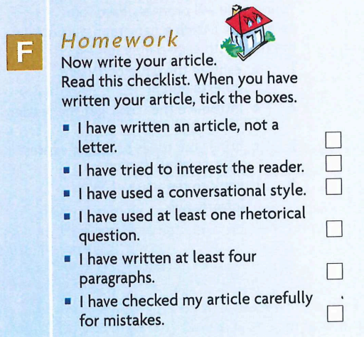

Slide 31
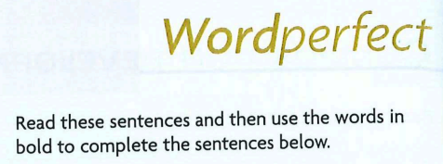

Slide 32
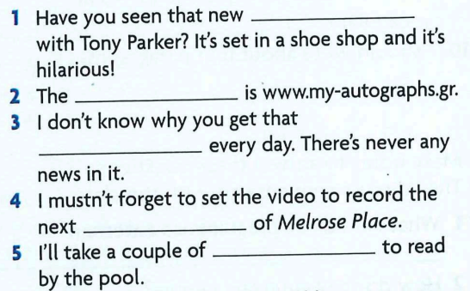
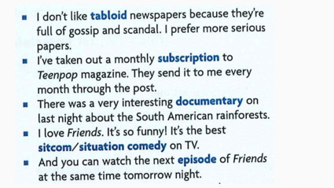
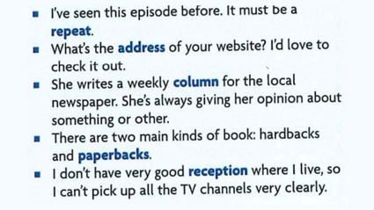
sitcom
address
1
2
3
4
5
tabloid
episode
paperbacks

Slide 33
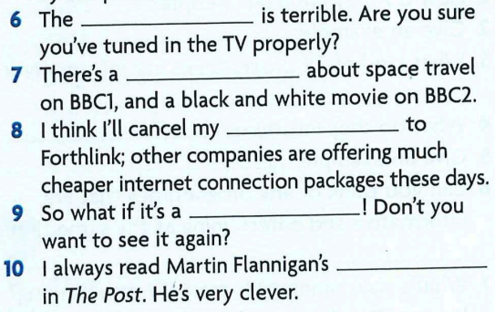
reception
documentary
subscription
6
7
8
9
10
repeat
column

Slide 34
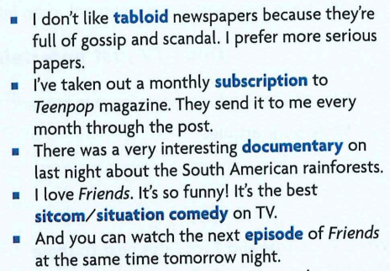

Slide 35
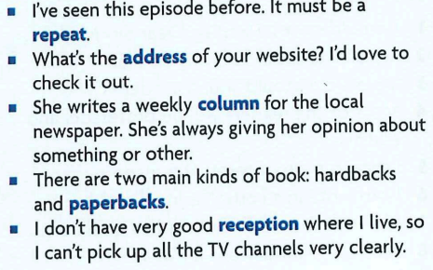

Slide 36

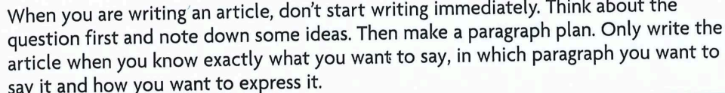

Slide 37
Each of these articles should be written in 120-180 words in an appropriate style.
1 Your favourite magazine is running a writing competition this month. The prize is a tour round a television studio. To enter the competition, you have to write an article describing your favourite television programme and explaining why you would recommend it to others.
Write your article.
2 Your school magazine is running a series of articles under the title 'Radio and Young People.' You have been asked to write an article to appear in the series giving your views on how popular radio is with young people today.
Write your article.

Slide 38

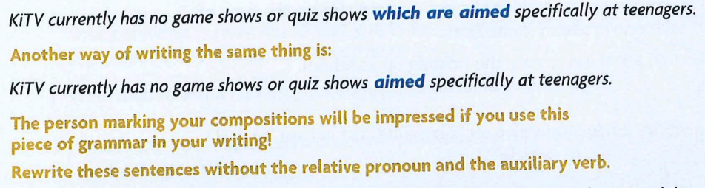

Slide 39
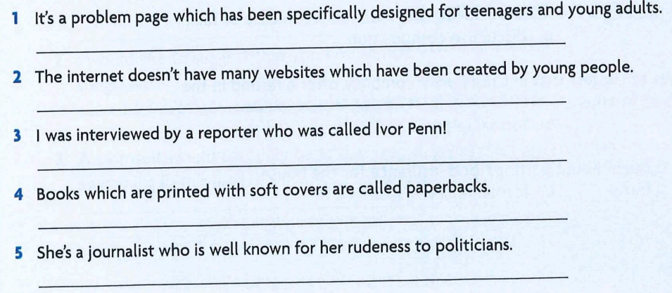
1
It’s a problem page specifically designed for teenagers and young adults.
2
The internet doesn’t have many websites created by young people.
3
I was interviewed by a reporter called Ivor Penn.
4
Books printed with soft covers are called paperbacks.
5
She’s a journalist well-known for her rudeness
to politicians.

